Slide 1
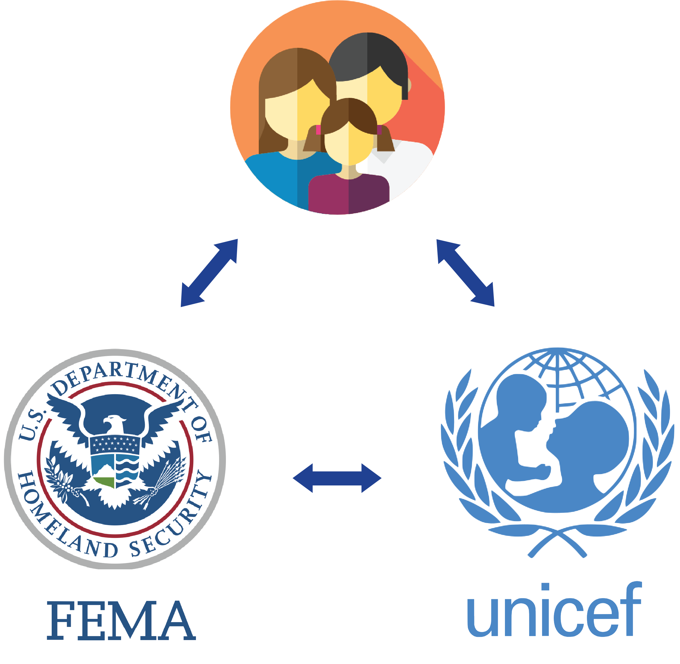

PREPARE
Plan | Provision | Prioritize

Slide 2
Private Citizens
Get Updates
Peace of Mind
Be Prepared

Slide 3
Agencies & NGOs
Reinforce evacuation orders
Identify private shelters
Heatmap of emergency supplies
Connect with citizens via SMS

Slide 4

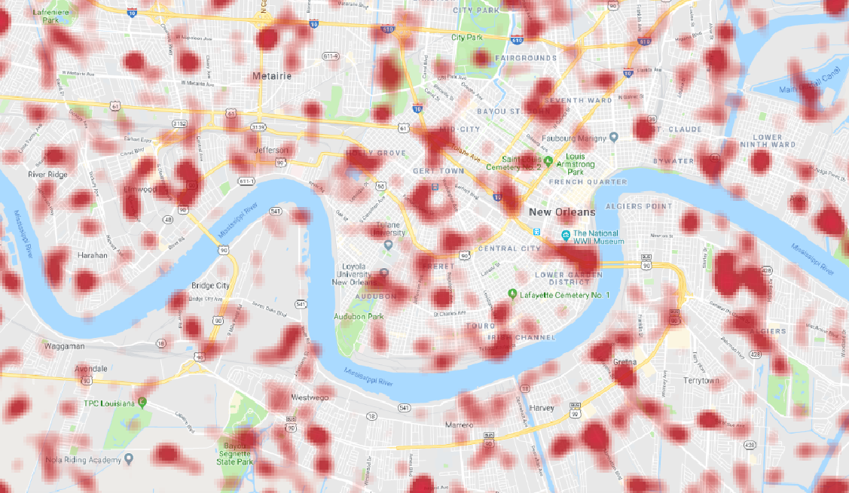



Visualize Private Shelters

Slide 5
Future Enhancements
Residents:
Enable residents to document the condition of their residence before and after the disaster
Report an issue
Allow people to respond with their updates via SMS
Government:
Leverage property records to predict the resilience of each house based on forecast data
Expose data about pre-storm supply levels to local retailers

